Slide 1
Lecture 16 Hydrogen comparison

Slide 2
ALTERNATIVE FUELS AND COMPARISON WITH FOSSIL OILS
Fuel | Type of vehicles | Cost competitiveness | Technology Status | Technology potential in coming decades | Environmental availability | Infrastructure availability
Petrol and diesel(fossil oils) | Both for light and heavy duty vehicles | LOW cost Of vehicles and running cost increase with rise in Oil prices | Mature fuel and vehicles and can be Used in hybrid Vehicles | Vehicle fuel efficiency Could increase (40 to 50%) | Current emissions are high but likely to reduce with improvements in vehicles | Widely existing
Biofuels | Both for light and heavy duty vehicles | Low cost Of vehicle but cost of fuel depends on biomass feedstock | Vehicles and conventional biofuels Proven but Technology for 2nd generation biofuels evolving | 2nd generation biofuels to reduce supply constraints And vehicle efficiency to fossil Oils | Varies with fuels and region and co2 may not always reduce vs. fossil oil | Can be blended with fossil oils the existing infrastructure
CNG | Both for light and heavy duty vehicles | Higher vehicle cost and fuel price linked somewhat to fossil Oil prices | CNG vehicle available and proven except for 2 wheelers | Vehicles efficiency similar to fossil oils | Lower CO2, and other emissions compared to fossil oils | Developing in some countries but not widely
Electricity | Battery size and weight limit its use in heavy vehicles | Vehicle costs high but running costs low | Efficient use Of energy. Some vehicles Available but limited production | Larger scale deployment depends on reduction in battery cost and user response | No tail pipe emissions depend on source of hydrogen | Required for recharging with augmentation in power generation
Hydrogen | Feasible for all vehicles but most practical for light duty vehicles | Vehicle cost and fuel cost high | Vehicles in RD&D with introduction of some Commercial models | Depends on fuel cells and on-board hydrogen storages | Clean but WTW emissions depend on source of hydrogen | Required to be developed for production and refueling

Slide 3
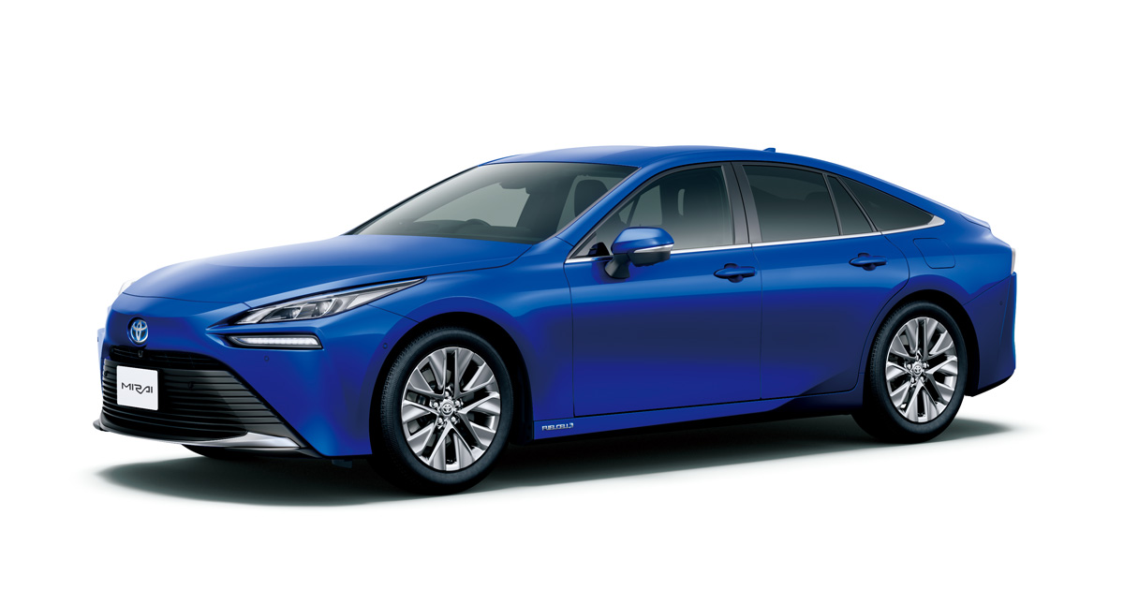
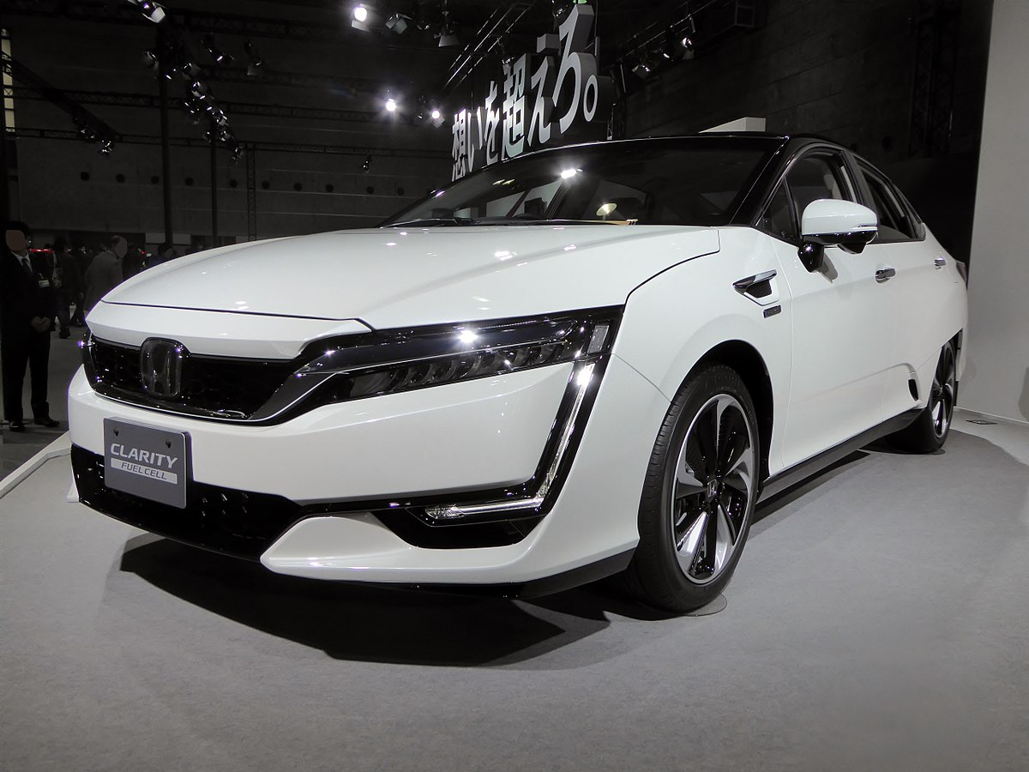
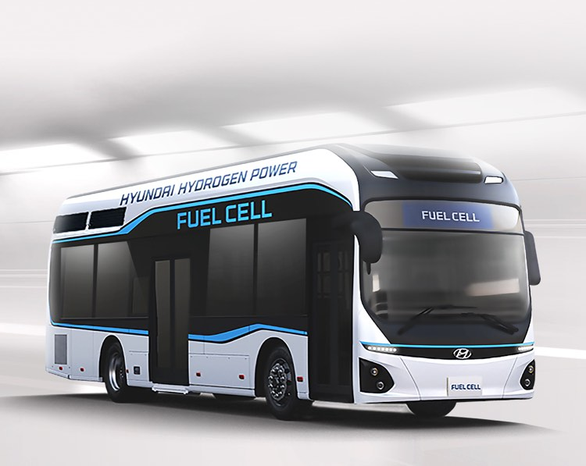
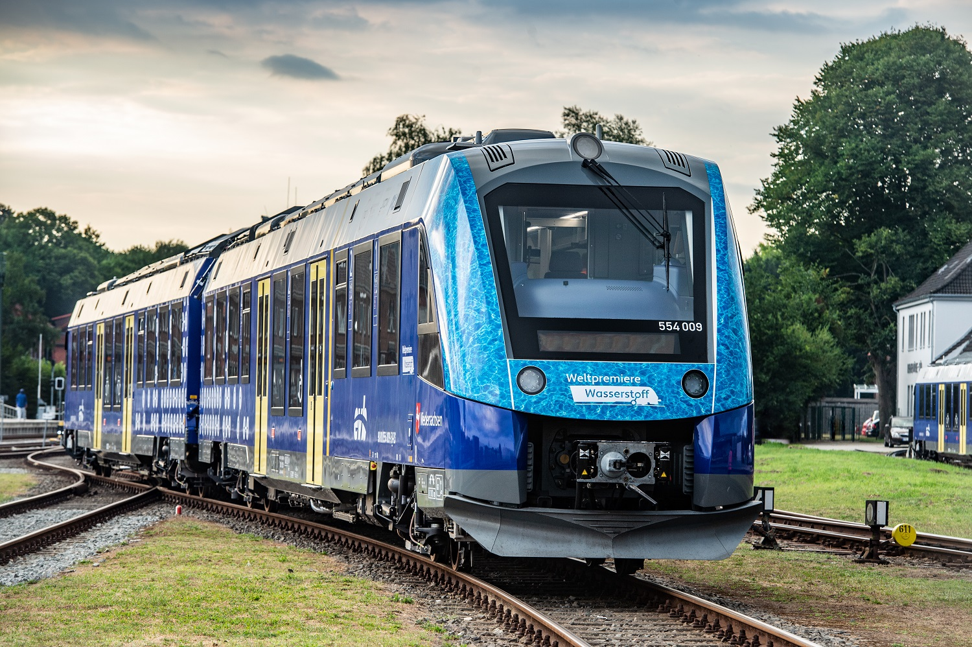
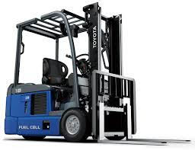
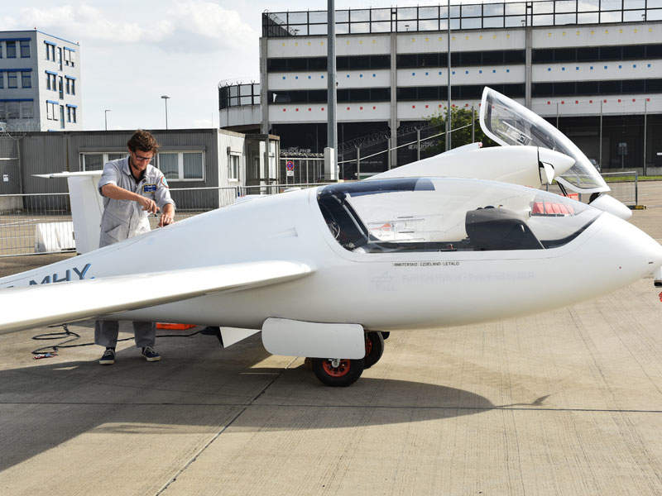
HYDROGEN FUELLED VEHICLES - GLOBAL STATUS
Estimated no. of hydrogen fuelled vehicles in
thousands
toyoto mira
honda clarity
Most vehicles are fuel cell based with on-board
storage of gaseous hydrogen at 350 bar / 700
bar
BMW and Ford Motors have demonstrated
hydrogen fuelled cars and buses using IC engine
technology
fuel cell bus
coradia ilint fuel cell train
Vehicles using H-CNG blends also being
demonstrated
Fuel Cell based buses demonstrated in Europe,
Iceland, China, Australia, USA, Canada, Brazil,
China etc.
fuel cell forklift
HY4 Fuel cell aircraft

Slide 4
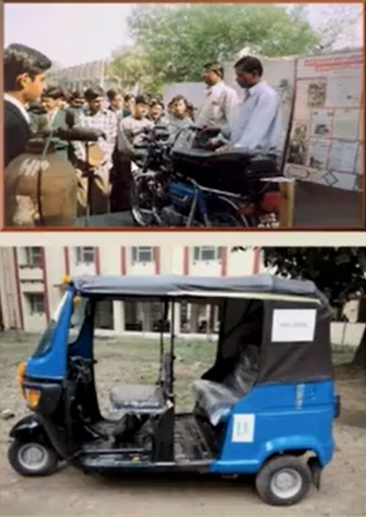
HYDROGEN MOTORCYCLES & THREE WHEELERS
BHtJ. VARANA.SI
Petrol driven motorcycle (100 cc, a stroke IC engine)
and 3 wheeler (175 cc, 4 stroke IC engine) converted
to operate with hydrogen as a fuel
hydrogen stored In metal hydride heat exchanger
hydrogen is released on moderate heating
hydride using exhaust gases
15 motorcycles are being demonstrated in BHU campus
Range: —50 km/charge of H, & top speed: —50 kmph
Eight 3-Wheelers being developed to improve range

Slide 5
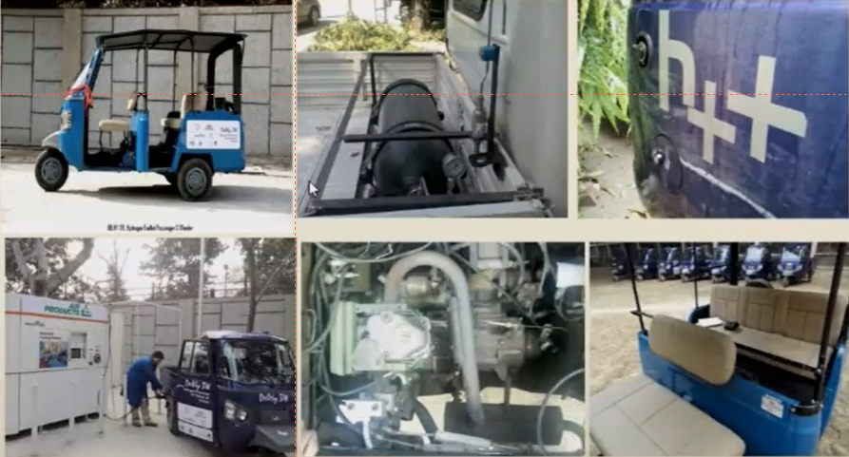
HYDROGEN THREE WHEELERS

Slide 6

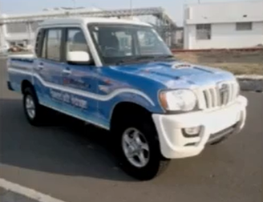
HYDROGEN-DIESEL SUV
M&M implemented a project on development &
Demonstration of hydrogen-diesel dual fuel SUV
And developed 5 vehicles
Saskatchewan Research Council (SRC), Canada
collaborated in designing dual fuel controller
Diesel engine modified to run on hydrogen-diesel
Dual fuel mode, collect the data for the pollution &
Performance; optimise it and undertake field:trials
Presently two vehicles undergoing field trials using
solar hydrogen refueling facility set up at NISE

Slide 7
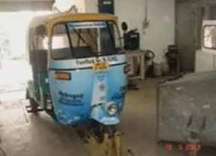

H-CNG FUELLED VEHICLES
project sanctioned demonstrating hydrogen (up to 30%)
blending with CNG in 3 buses, 2 cars and 2 three wheelers to SIAM in September 2007.Project is likely to be completed by end 2013
First project to be sanctioned with participation Of industry based on recommendations Of Hydrogen Road Map
SIAM, IOCL and 5 Auto companies i.e. Tata Motors, Ashok Leyland, Volvo-Eicher M&M and Bajaj Auto participated in project
based on performance and emissions tests undertaken, it was decided to blend 18% hydrogen by volume with CNG
Field trials up to 30,000 km for 3-wheelers and 50,000 km for other vehicles were planned / undertaken
Project helped in optimization of engine performance and blend ratio of
Hydrogen with CNG

Slide 8
Thank you

